Slide 1
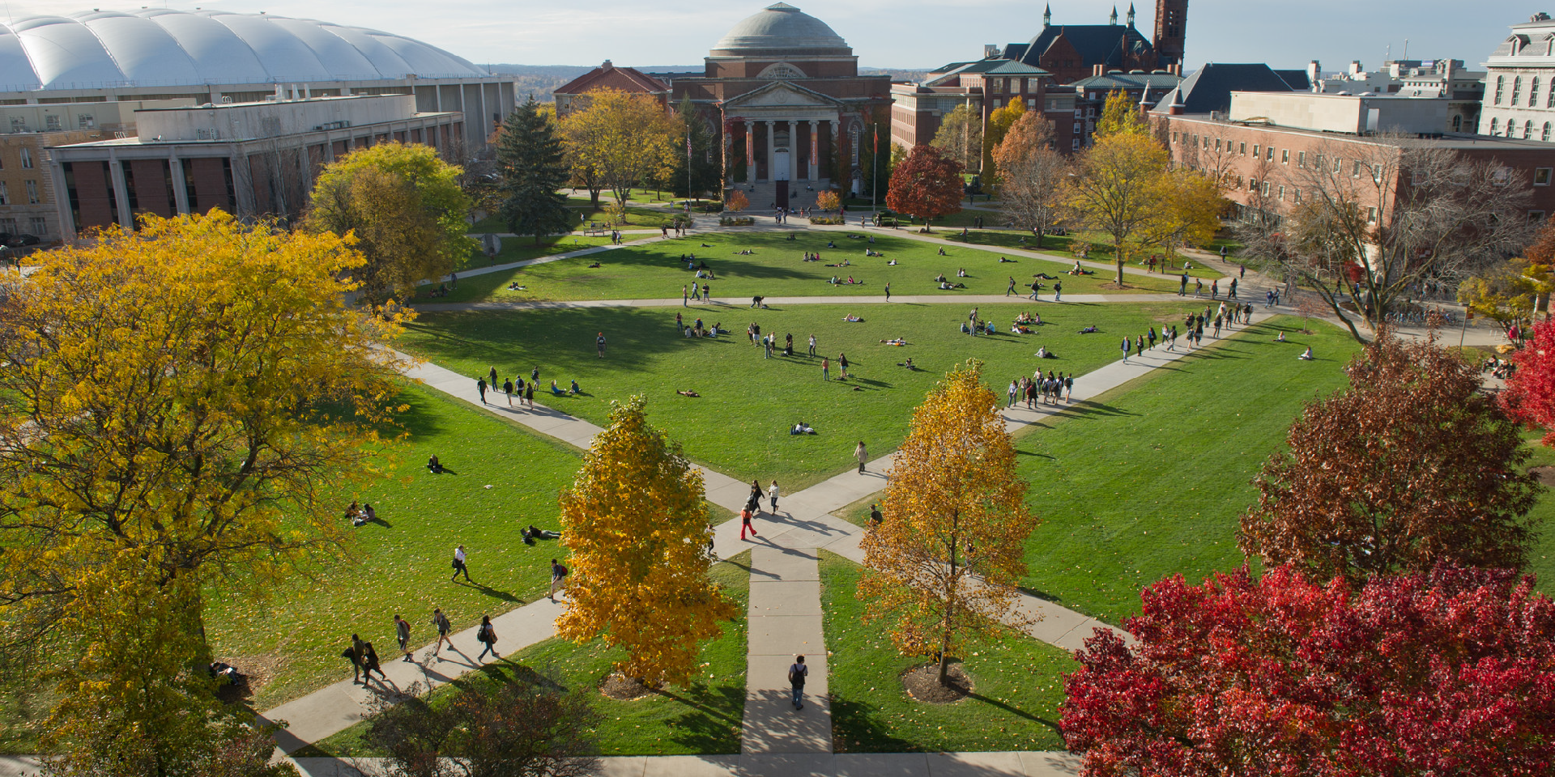
Introduction to Natural Language
Processing

Slide 2
Natural Language Processing (NLP)
A range of computational techniques
for analyzing and representing naturally occurring texts at one or more levels of linguistic analysis
for the purpose of achieving human-like language processing
for a range of particular tasks or applications
Computational linguistics: doing linguistics on computers
Closely related, often treated as synonymous with NLP
“The field is Computational Linguistics, but what computational linguists do is Natural Language Processing”
2

Slide 3
Natural Language as the User Interface
Goal is complete natural language understanding
Enables computers to interact with humans with natural language
Vision of a future with HAL in 2001: A Space Odyssey
Most common current approach is to craft human/computer interfaces that are in terms that the computer can understand
XML, drop-down boxes, other forms of knowledge representation
Cleverness is supplied by the human
Nascent natural language interfaces are being deployed
Apple’s Siri, the Google Assistant, Amazon’s Alexa
3

Slide 4
Where Is NLP Now?
Goals can be far-reaching
True text understanding
Reasoning about knowledge in text
Real-time participation in spoken dialogues
Or very down to earth
Finding the price of products on the web
Context-sensitive spell-checking
Analyzing sentiment and opinions statistically
Extracting facts or relations from documents
Remembering previous searches and contexts to guide future interactions
Currently, NLP is providing these practical applications
(yet still dreaming of the AI goals)
4

Slide 5
Need for NLP
Huge amounts of data
Internet and Intranet
Applications for processing large amounts of texts require NLP expertise
Data Science/Text Mining
Classify text into categories Index and search large texts
Automatic translation of web documents in different languages
Speech understanding, e.g. phone conversations
Information extraction, e.g. extract useful information from resumes
Automatic summarization
Condense one book into one page Daily news summaries
Question answering Knowledge acquisition Text generations/dialogues
5

Slide 6
Fields Contributing to NLP
Linguistics
Formal, structural models of language
Computer science
Internal representations of data and algorithms for efficient processing
Artificial intelligence
Computational theory of human language processing
Statistics
Frequencies and probabilities of linguistic patterns
NLP
Cognitive psychology
Human cognition in language
Theoretical
Applied
6

Slide 7
Two Sides of NLP:
Analysis and Generation
Paraphrase an input text
Translate it to another language or representation
Answer questions about it
Draw inferences from it
Phrase the results in natural language
Natural language processing
Language analysis*
*Main emphasis in this course
Language generation
7

Slide 8
Synchronic Model of Language
The synchronic model postulates levels of language to understand the use of language at this point in time.
Pragmatic
Discourse
Semantic
Syntactic
Lexical
Morphological Phonetic
8

Slide 9
Why Is NLP So Hard?
Seems pretty simple for humans
Usually quite unaware of the complexity of the language tasks they perform so effortlessly
Some reasons are:
Ambiguity
Subtleties of meaning
Irony, sarcasm, humor, metaphor
9

Slide 10
Ambiguous Newspaper Headlines
Ban on Nude Dancing on Governor’s Desk Iraqi Head Seeks Arms
Juvenile Court to Try Shooting Defendant Teacher Strikes Idle Kids
Stolen Painting Found by Tree
Local High School Dropouts Cut in Half Red Tape Holds Up New Bridges
Clinton Wins on Budget, but More Lies Ahead Hospitals Are Sued by 7 Foot Doctors
Kids Make Nutritious Snacks
Examples collected by Chris Manning
10

Slide 11
Exercise 1.3.2
Suppose that we have this sentence:
I made her duck.
On first reading, suppose that you interpret the meaning of this sentence to be: I cooked waterfowl for her benefit to eat.
What other meanings can you think of for this sentence?
11

Slide 12
Introduction to NLP
Applications

Slide 13
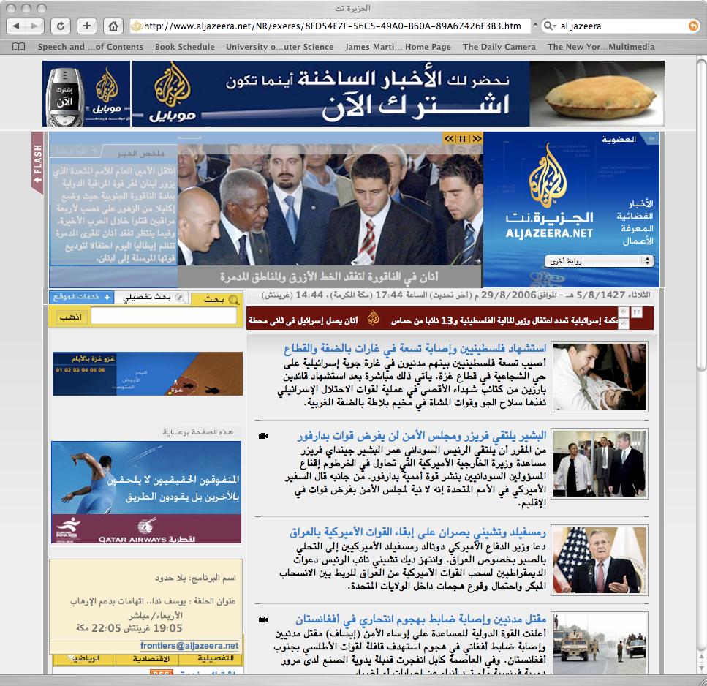
NLP Application Areas
Machine translation (MT): conversion of text from one language to another
Google, Yahoo, and Bing all have language translators
MT techniques use context, not just word-for-word substitution
Often statistically based patterns of word usage and context
Google Translate

Slide 14
NLP Application Areas
Information retrieval/search engines: provision of documents containing requested information
Google, many other search engines
Use lowest levels of NLP to stem words, find phrases for indexing documents
Users conform to keyword query restriction, but many search engines will now accept questions in natural language form

Slide 15
NLP Application Areas
Information extraction/text-mining: populating a structured database with specific bits of information found in text
Competitive intelligence analyzes news text and web blogs for:
Names of people, companies, and other entities
Relations between them (e.g., corporate roles) or events such as mergers
Weblog Analytics
Data-mining of weblogs, discussion forums, message boards, user groups, and other forms of user-generated media
Product marketing information
Political opinion tracking, Social network analysis
Buzz analysis (what’s hot, what topics are people talking about now)

Slide 16
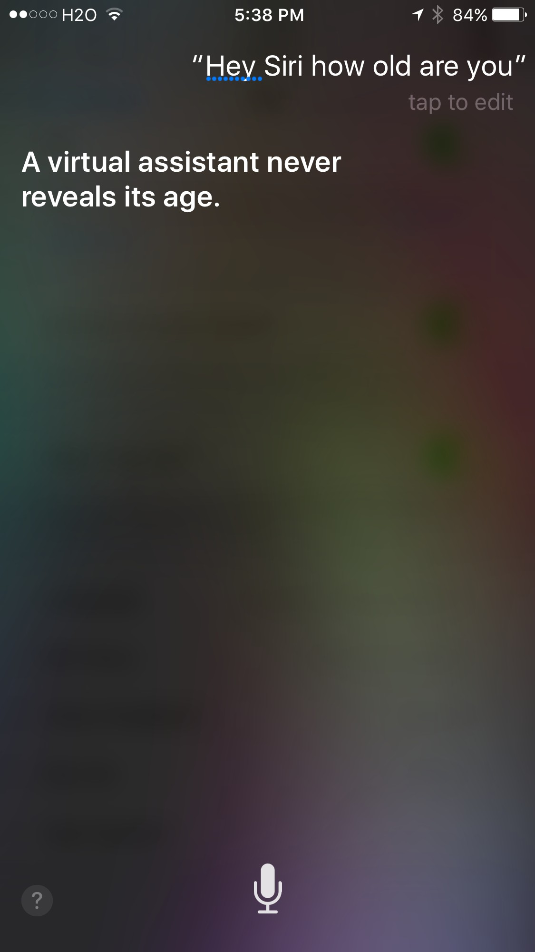
NLP Application Areas
Human–computer interfaces:
information assistants,
chatbots, automatic phone agents, interactive querying of databases

Slide 17
NLP Application Areas
Summarization: abstraction and condensation of text’s major points
Current systems select a set of significant sentences from the document as a summary
Example summarizer
http://textsummarization.net/text-summarizer

Slide 18
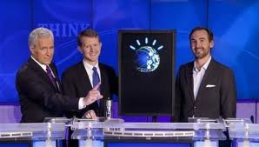
NLP Application Areas
Question-answering systems: focused information provision
Find answers to questions in documents or other resources
Must be able to handle many different phrasings of desired answer and to provide justification
Watson
IBM’s question-answering system trained to play Jeopardy
Extensive development of NLP techniques

Slide 19
Trends
An enormous amount of knowledge is now available in machine-readable form as natural language text.
Conversational agents are becoming an important form of human–computer communication.
Much of human–human communication is now mediated by computers.

Slide 20
Exercise 1.3.4
What form(s) of human computer interface have you experienced?

Slide 21
Levels of Language:
Part 1

Slide 22
Levels of Language Analysis
Use the synchronic model to guide computational techniques to analyze text (as much as possible).
Pragmatic
Discourse
Semantic
Syntactic
Lexical
Morphological Phonetic
2

Slide 23
Levels of Language
The more exterior the level of language processing:
The larger the unit of analysis
Phoneme -> morpheme -> word -> sentence -> text -> world
The less precise the language phenomena
The more free choice and variability
The less rule-oriented, more exceptions to regularities
The more levels it presumes a knowledge of or reliance on
Theories used to explain the data move more into the areas of cognitive psychology and AI
Lower levels of the model have been more thoroughly investigated and incorporated into NLP systems
3

Slide 24
Speech Processing
Interpretation of speech sounds within and across word
sound waves are analyzed and encoded into a digitized signal.
Rules used in Phonological Analysis
Phonetic rules: sounds within words
Phonemic rules: variations of pronunciation when words are spoken together
Prosodic rules: fluctuation in stress and intonation across a sentence—rhythm, volume, pitch, tempo, and stress
Separating the spoken word “cat” into three distinct phonemes, /k/, /æ/, and /t/, requires phonemic awareness.
4

Slide 25
Morphological Analysis
Deals with the componential nature of lexical entities:
Prefix pre – registra – tion suffix
stem/root
What features do inflections reveal in English?
Verbs Nouns Adjectives
tense and number single/plural
comparison features
5

Slide 26
Lexical
Adding lexical class information to words:
Part-of-speech (POS) tagging tags words with specific noun, verb, adjective, and adverb types.
03/14/1999 (AFP)… the extremist Harkatul Jihad group, reportedly backed by Saudi dissident Osama bin Laden…
… the|DT extremist|JJ Harkatul_Jihad|NP group|NN,|, reportedly|RB backed|VBD by|IN Saudi|NP dissident|NN Osama_bin_Laden|NP…
The POS tags in this example are taken from the Penn Treebank tag set.
6

Slide 27
Lexical: Word Meanings
Usually given by online lexicon such as WordNet Word with senses
Example: launch
Definitions
Noun sense 1: a large, usually motor-driven boat used for carrying people on rivers, lakes, harbors, etc.
Verb sense 1: set up or found
Synonyms
Verb sense 1: establish, set up, found
7

Slide 28

Syntactic Analysis
Analyzing of words in a sentence so as to uncover the grammatical structure of the sentence:
How words are grouped to form phrases and the order in which they occur Requires both a grammar and a parser
Produces a delinearized representation of a sentence, which reveals dependency relationships between words
S
Tree Structure
VP
PP
NP
VP2
Prep
NP
Determiner
NP2
Aux
Verb
Determiner
NP2
Adjective
Noun
Noun
The
glorious
sun
will
shine
in
the
winter
8

Slide 29
Sentence
Noun phrase
Verb phrase
Determiner
Noun
Verb
Noun phrase
Determiner Noun
The cat ate the mouse
The phase structure rules underlying this analysis are as follows:
Sentence Noun phrase Verb phrase
Determiner = The Noun = cat
Noun = mouse Verb = ate
Noun phrase Determiner
Verb phrase Noun
Verb Noun phrase
Parsing a sentence using simple phrase structure rules
9

Slide 30
Syntactic Ambiguity: We Fed Her Dog Bones
S
VP
NP
V
NP
NP
Adj
Noun
Noun
We
fed
her
dog
bones
S
VP
NP
V
NP
NP
Noun
Adj
Noun
We
fed
her
dog
bones
10

Slide 31
Levels of Language:
Part 2

Slide 32
Semantics
Determining possible meanings of a sentence
Interactions among words affect lexico-semantic interpretation
Capturing meaning of a sentence in a knowledge representation formalism

Slide 33
Semantic Role Labeling (SRL) Problem
In a sentence, a verb and its semantic roles form a proposition; the verb can be called the predicate, and the roles are known as arguments.
Given a target verb, the semantic role labeling task is to identify and label each semantic role present in the sentence.
When Disney offered to pay Mr. Steinberg a premium for his shares, the New York investor didn’t demand the company also pay a premium to other shareholders.
Example roles for the verb “pay,” using roles more specific than theta roles:
When [_{payer} Disney] offered to [_{V} pay] [_{recipient} Mr. Steinberg] [_{money} a premium] for [_{commodity} his shares], the New York investor…

Slide 34
Semantic Relation Extraction
Coca-Cola Enterprises, Inc. said its Atlanta Coca-Cola Bottling Co. unit and its CEO, John Smith, is a target of an investigation into alleged antitrust violations in the soft-drink industry by a federal grand jury
in Atlanta.
Extracted relations:
Owns Employs Location Location
Coca-Cola Enterprises, Inc. Coca-Cola Enterprises, Inc. Coca-Cola Bottling Co.
Federal grand jury
Coca-Cola Bottling Co. John Smith
Atlanta Atlanta

Slide 35
Discourse Level
Determining meaning in texts longer than a sentence Making connections between component sentences
Multi-sentence texts are not just concatenated sentences to be interpreted singly
Documents may have distinct patterns in different sections: introduction, conclusions, methodology, etc.
Text in dialogues has distinct forms according to position in the dialogue
Interpretation of later-mentioned entities depends on interpretation of earlier-mentioned entities—“coreference”

Slide 36
Anaphora (Coreference) Resolution
Excerpt from story by Farhad Manjoo of Slate, “Siri vs. Google,” 2014. The coreference is to understand the meaning of the word “his” in the second sentence.
“Google Voice Search isn’t close to realizing that vision, but it’s not impossibly far off either. Huffman points out that Google’s app can already hold very small conversations. It understands pronouns, so if you ask, ‘Who is Barack Obama?’ and then ask, ‘Who is his wife?’, it knows that his refers to Obama. And most important, it gives you the correct answer.
I just tried the same set of queries with Siri. First, she correctly identified the president. But when I asked, ‘Who is his wife?’ she shot back, ‘What is your wife’s name?’ That’s not what I asked.”

Slide 37
Pragmatics
The purposeful use of language in situations
A functional perspective: understanding the person’s purpose in using the text
Those aspects of language that require context for understanding
Goal is to explain how extra meaning is read into texts without actually being encoded in them
Requires much world knowledge
Understanding of intentions/plans/goals

Slide 38
Pragmatics
TAKE-TRIP
BUY-TICKET
GOTO-TRAIN
GETON-TRAIN
GOTO-TICKETBOOTH GIVE MONEY RECEIVE-TICKET
Sketch of a commonsense task plan to take a trip

Slide 39
Techniques for NLP Analysis
Corpus Statistics
Frequencies of words
Frequencies of word pairs, using co-occurrence or semantic measures
Classification or Other Machine Learning
Use NLP to produce features, also known as attributes, of the text
Classify the text according to a set of labels
Classify customer reviews as positive or negative
Classify news articles according to topic

Slide 40
Exercise 1.3.7
For the following terms, describe whether they occur at the level of: parts of words, words, sentences, or entire documents.
Morphological
Discourse
Semantics
Syntactic
Lexical

Slide 41
Exercise 1.3.7 (Answers)
For the following terms, describe whether they occur at the level of: parts of words, words, sentences, or entire documents.
Morphological
Parts of words
Discourse
Documents
Semantics
Sentences
Syntactic
Sentences
Lexical
Words

Slide 42
Corpus Words

Slide 43
First Text-Processing Task: Word Counts
Preliminary Text Processing Required Define the words so that you can count them.
Filter out “junk data.”
Formatting/extraneous material
First, be sure it doesn’t reveal important information
Deal with upper-/lowercase issues.
Ignore capitalization at beginning of sentence? Is “They” the same word as “they”?
Ignore other capitalization? In a name such as “Unilever Corporation” is “Corporation” the same word as “corporation”?

Slide 44
Preliminary Processing Required
Tokenization (or Word Segmentation)
Decide how to separate the characters in the sentence into individual words
Words separated by “white space” or by special characters in English
No white space in Japanese language
In some languages, there are complex compound words: “Lebensversicherungsgesellschaftsangestellter”
Requires decisions on recognizing and dealing with punctuation
Apostrophes (one word it’s vs. two words it ’s)
Hyphens (snow-laden vs. New York-New Jersey)
Periods (kept with abbreviations vs. separated as sentence markers)

Slide 45
Preliminary Processing Required
Morphology (to stem or not to stem?)
Depends on the application
With stemming
“Cat” is the same word as “cats”
“Computing” is the same word as “compute”
Additional issues if OCR’d data or speech transcripts in order to correct transcription errors

Slide 46
Word Counting in Corpora
Terminology for word occurrences
Tokens: the total number of words
Distinct tokens (sometimes called word types): the number of distinct words, not counting repetitions
The following sentence from the Brown corpus has 16 tokens and 14 distinct tokens:
They picnicked by the pool, then lay back on the grass and looked at the stars.

Slide 47
Word Frequencies
Count the number of each token appearing in the corpus (or sometimes single document)
A frequency distribution is a list of all tokens with their frequency, usually sorted in the order of decreasing frequency
Used to make “word clouds”
For example: http://www.tumblr.com/tagged/word+cloud

Slide 48
Exercise 1.4.2
Excerpt from Alice in Wonderland:
“In that direction,” the Cat said, waving its right paw round, “lives a Hatter: and in that direction,” waving the other paw, “lives a March Hare. Visit either you like: they’re both mad.”
“But I don’t want to go among mad people,” Alice remarked. “Oh, you can’t help that,” said the Cat: “we’re all mad here. I’m mad. You’re mad.” “How do you know I’m mad?” said Alice. “You must be,” said the Cat, “or you wouldn’t have come here.”
Please review the text above and count the number of the following words:
the
mad
I
either
Which of these words is the most frequent?
Notes:
This gives a partial frequency distribution of the words in this text.

Slide 49
Natural Language Processing ToolKit
(NLTK)

Slide 50
Processing Text With NLTK
NL ToolKit provides libraries of many of the common NLP processes at various language levels.
Leverage these libraries to process text.
The goal is to learn about and understand how NLP can be used to process text without programming all processes.
However, some programming is required to:
Call libraries
Process data
Customize NLP processes
Programming language is Python.

Slide 51

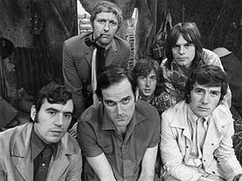
Python and NLP
Python is freely available for many platforms from the Python Software Foundation:
http://www.python.org/
Named for the group Monty Python
We are using Python version 3.x
Not backward compatible with Python 2.x
The group in 1969

Slide 52
Characteristics of Python
Easy-to-learn scripting language, similar in many aspects to Perl
But with WYSIWYG block structure
Object-oriented, with modules, classes, exceptions, high-level dynamic data types, similar to Java
Strongly typed, but without type declarations (dynamic typing) Regular Expressions and other string-processing features Many libraries offer wide functionality
https://xkcd.com/353/

Slide 53

Natural Language ToolKit (NLTK)
A suite of Python libraries for symbolic and statistical
natural language programming
Developed at the University of Pennsylvania
Developed to be a teaching tool and a platform for research NLP prototypes
Data types are packaged as classes
Goal of code is to be clear, rather than fastest performance
But, increasingly, production-level software is made available through wrappers

Slide 54
Natural Language ToolKit (NLTK)
Latest version is compatible with Python 3.x
Online book: http://www.nltk.org/book/ Authors:
Edward Loper, Ewan Kline, and Steven Bird

Slide 55
Software Installation: Python 3x & NLTK
Please download instructions for the installation of Python 3.x, NLTK, and Jupyter Notebook located on BB in the folder: Lectures - Week 1 .
nlp_lab_installing_nltk.doc

Slide 56
Lab Session – Week 1: Processing Text in NLTK
Please download Lab files located on BB in the folder: Lectures - Week 1.
lab1.setup.pythonintro.doc
lab2.morepython.doc
lab3.nltkwords.doc
lab4.nltkfreqdist.doc
These files contain instructions and snippets of python code for you follow and apply to gain an understanding of the concepts learned in this lecture.

Slide 57
Lab Session – Week 1: Processing Text in NLTK
Lab Session - Week 1 Homework
Following the steps in the Lab Parts 2 and 3, pick a different file number for the Gutenberg books, change the variable “fileno” to this number and rerun the steps to create a frequency distribution, FreqDist , for this book.
Steps:
Get the text with nltk.corpus.gutenberg.raw()
Get the tokens with nltk.word_tokenize()
Get the words by using w.lower() to lowercase the tokens
Make the frequency distribution with FreqDist
Get the 30 top frequency words with most_common(30) and print the word, frequency pairs.
Submit a report summary that includes the title of the book that you chose, the list of word frequency pairs of the top frequency words, observations, and lessons learned. In addition to the report summary, upload a copy of the python code you developed as part of this lab.

